Slide 1
LANGUAGE IDENTIFICATION AND TRANSLATION USING NEURAL NETWORKS
Under the esteemed guidance of
Dr. Y. Jhansi
Assistant Professor
Dept. of C.S.E.
GITAM (Deemed to be University)
Visakhapatnam
Submitted by:
D.V.ANAND SAI 121710303011
K.ROHITH 121710303025
P.CHARITH REDDY 121710303042

Slide 2
Abstract
With the coming of Deep learning numerous new Language Translation Methods (LTM) have been conceivable with regards to Natural Language Processing (NLP). One such method is the Language translation utilizing neural networks in Deep Learning (DL). To this method to be carried out the language of the content or sound must be recognized which is done manually. We might want to propose a system where we merge the Language Identification System (LID) with the translation framework in order to recognize the language and input the equivalent to the translation framework. To carry out this LID, we utilize the methodology of Long Short-Term Memory (LSTM) , a sort of Recurrent Neural Network. The input will be given as text and will be distinguished which language it is and afterward be translated into the language needed. These LSTM within the RNN framework have shown promising results in many of the researches done by other Research Groups when compared to that of the Machine Learning methodologies like Naive Bayes, Support Vector Machines and so on. To build these Deep Learning frameworks we will utilize built-in frameworks like numpy, pandas, matplotlib, NLTK for Natural Language Processing, TensorFlow and Keras for carrying out DL methodologies in the Python programming language. The Integrated Development Environment (IDE) which we use will be Jupyter notebook and Spyder within the Anaconda environment for Version control. At last we will create a front end where the end client could give the input for the purpose of translation.

Slide 3
CONTENTS
Introduction
Deep Learning
Natural Language Processing
Uses of Natural Language Processing
Literature Survey
Problem Identification and Objectives
Language Identification and Translation Problem
Objectives and Proposed Solution
Methodology
Language Identification
Language Translation
Datasets

Slide 4
Implementation
Language Translation
Language Identification
Integration of both
Front end
Results
Conclusion
References

Slide 5
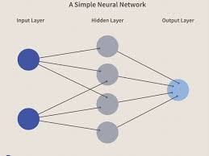
Introduction
Deep Learning:
Deep Learning is a subset of Machine Learning, which on the other hand is a subset of Artificial Intelligence. Artificial Intelligence is a general term that refers to techniques that enable computers to mimic human behaviour.

Slide 6
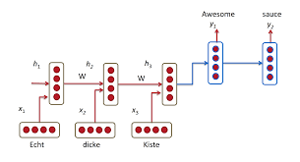
The design of the neural network is based on the structure of the human brain. Just as we use our brains to identify pattern.

Slide 7
Natural Language Processing:
It is a discipline that focuses on the interaction between data science and human language, and is scaling to countless industries.
Today, NLP is booming because of huge improvements in the access to data and increases in computational power, which are allowing users to achieve meaningful results in areas like healthcare, media, finance, and human resources, among others.
NLP has primarily two aspects:
Natural language understanding (NLU) or natural language interpretation (NLI) (human to machine)
Natural language generation (NLG) (machine to human)

Slide 8
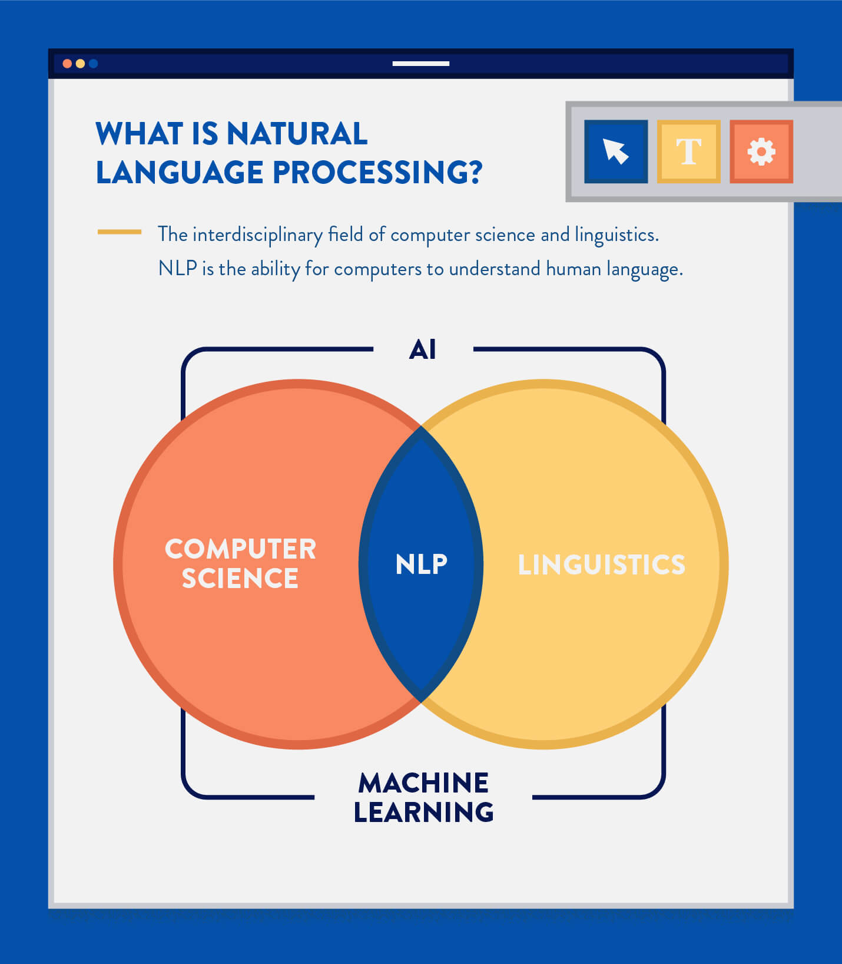
NLP is divided into two fields:
Linguistics and Computer Science.
The Linguistics side is concerned with language,
it’s formation, syntax, meaning, different kind
of phrases (noun or verb).
2. The Computer Science side is concerned with
applying linguistic knowledge, by transforming
it into computer programs with the help of sub-fields
such as Artificial Intelligence.

Slide 9
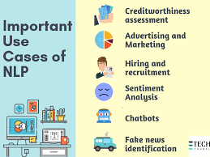
Uses of Natural Language Processing:
NLP enables the recognition and prediction of diseases based on electronic health records and patient’s own speech. Amazon Comprehend Medical is a service that uses NLP to extract disease conditions, medications, and treatment outcomes from patient notes, clinical trial reports, and other electronic health records.
Organizations can determine what customers are
saying about a service or product by identifying
and extracting information in sources like social
media. This is called as sentiment analysis.

Slide 10
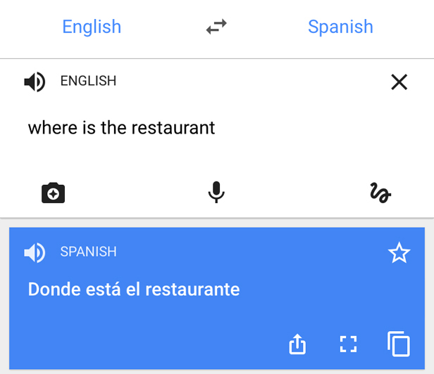
An inventor at IBM developed a cognitive assistant that works like a personalized search engine by learning all about you and then remind you anything you can’t remember the moment you need it to.
Companies like Yahoo and Google filter and classify your emails with NLP by analyzing text in emails that flow through their servers and stopping spam before they even enter your inbox.
To help to identify fake news, the NLP
Group at MIT developed a new system
to determine if a source is accurate or
politically biased, detecting if a news
source can be trusted or not.
Amazon’s Alexa and Apple’s Siri are
examples of intelligent voice interfaces
that use NLP.

Slide 11
Literature survey
“Language Identification Using Deep Convolutional Recurrent Neural Networks” which is published by Christian Bartz, Tom Herold, Haojin Yang and Christoph Meinel from the Hasso Plattner Institute, University of Potsdam. We/ implemented this RNN model in our project using the concept of identity vectors or the i - vectors concept taken from “Automatic Language Identification Using Deep Neural Networks” an IEEE research paper.
We have considered the usage of RNN because RNN model in LSTM approach has given very accurate results when compared to that of the other approaches such as the Multinomial Naive Bayes and Logistic Regression as stated by Priyank Mathur, Arkajyoti Misra and Emrah Budur in their paper titled “Language Identification from Text Documents”.

Slide 12
Problem identification and objectives
Language Identification and Translation Problem:
The language identification (LID) is a technique of determining the given language input in various formats like text, speech, video and so on.
The problem corresponds to the automatic language detection during translation of the languages where the user has to specify the language in which the input will be given.
Instead of that we propose a combination of this language identification and translation models where the given input would be first monitored for the identification of the language and then it would be translated.

Slide 13
There are several existing API (Application Programming Interfaces) in Python that are the interfaces of the Google translator such as the Goslate, Google Translate and so on. We have chosen Goslate and compare the results between our model and those of the Goslate.
The language translation model is also built on a similar notion.
The language translation would be done once the language itself has been identified.
Thus at first the Identification model is run and then the Translation model is executed.
In implementation the translation model has to be built first so as to understand the dynamics of passing the parameters to the same from the Identification model.

Slide 14
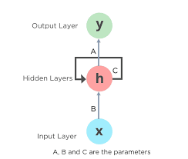
Objectives and Proposed Solution:
The Recurrent Neural Networks (RNN’s) are a part of the Artificial Neural Networks (ANN’s) and the Deep Recurrent Neural Networks (DNN’s) are specialised forms of RNN’s.
They come under the category of Feedforward Neural Networks and
exhibit the property of temporal dynamic behaviour by counting in
the previous nodes output as the input to the current node.
There are kinds of RNN’s like the Long Short-Term Memory (LSTM),
Bi - Gated Recurrent Units (GRU’s) and so on.
The LSTM has a widespread usage when it comes to Natural
Language Processing (NLP) techniques such as translation of the
languages, language identification, multilingual language processing.
Recurrent Neural Network remembers the past and it’s decisions are
influenced by what it has learnt from the past.
For example, an image classifier learns what a “1” looks like during training and then uses that knowledge to classify things in production.

Slide 15
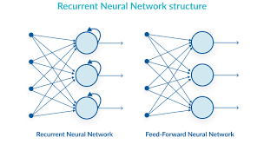
RNN’s take one or more input vectors and produce one or more output vectors while considering the
previous node’s output vectors as the inputs to the current one along with the weights.

Slide 16

Combining the RNN using LSTM with the Convolutional Neural Network (CNN) yielded greater
results while identifying languages from the text inputs.

Slide 17
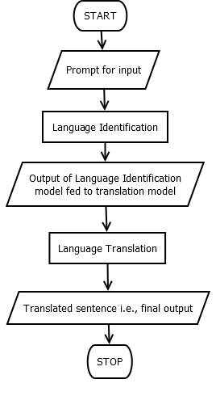
Methodology

Slide 18
Language Identification:
In the NLP the problem of language identification corresponds to observing the language and recognizing which language it is.
This problem could be answered by using the RNN model along with the power of softmax activation function so as to guess the language.
The LSTM a kind of RNN’s are used so as to classify the given input depending on the features that were extracted during initial phase of the implementation i.e., data preprocessing.
After identifying the language the output is given as the input to the next phase for the translation purpose.
Language Translation:
This phase also contains an LSTM model that takes the input as the kind of language and the features extracted from the data.
This model then tries to translate the given input and produce an output in the format of a text.
The model would do that by considering the previous output and the new input so as to hold on to the context of the given input.

Slide 19
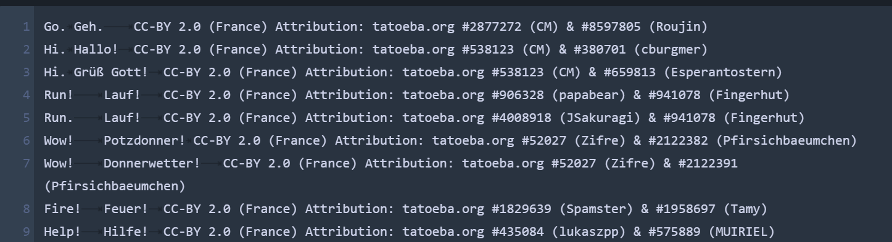
DATASETS
The datasets for the project have been taken from the Tatoeba Project which is a language project website where there are different datasets available for the purpose of the NLP projects.
We have taken the datasets for the french and german language which will have an english sentence delimited by a tab following a german translated sentence and then followed by the attributes of the owner which will be eliminated in the data preprocessing phase.

Slide 20
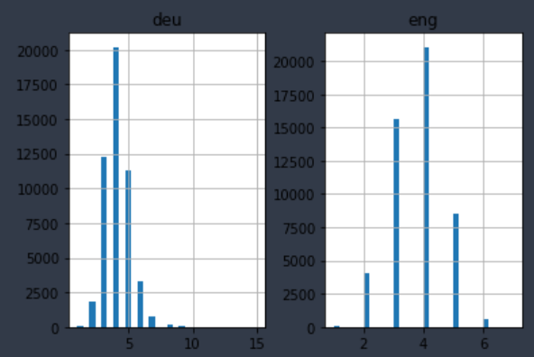
Implementation
Language Translation:
The following steps have been followed in implementing the translation system.
Reading of the text from the file.
Text preprocessing:
Removal of spaces and tabs.
Removal of punctuations.
Conversion to lowercase.
Comparison of the text lengths.
Tokenization of lists.
Encoding of lists.
Splitting of data into training and testing models.
Defining the model with respect to the dense layers, activation functions and other parameters.
Defining the optimizers and compiling the model.
Running the epochs.
Saving the model.

Slide 21
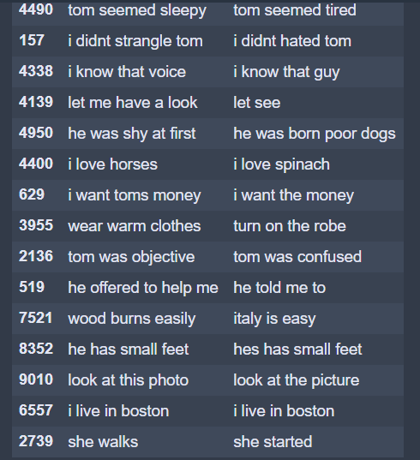

Slide 22
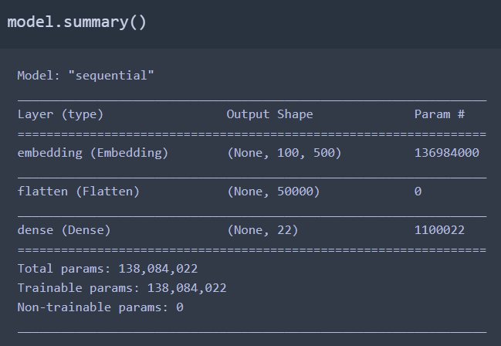
Language Identification:
Reading the data from the CSV file.
Then preprocessing the data i.e.,
Checking for the number of objects in the dataset.
Converting the text to lowercase.
Getting basic info.
Build a tokenizer to tokenize the data.
Build a labelencoder to label encode the
languages column values.
Split the dataset in the ratio of 80:20.
Build a keras model using the sequential
embedding with softmax activation
function.
Compile the model using categorical
cross entropy loss function.
Then fit and run the model to a
maximum of 3 epochs.

Slide 23
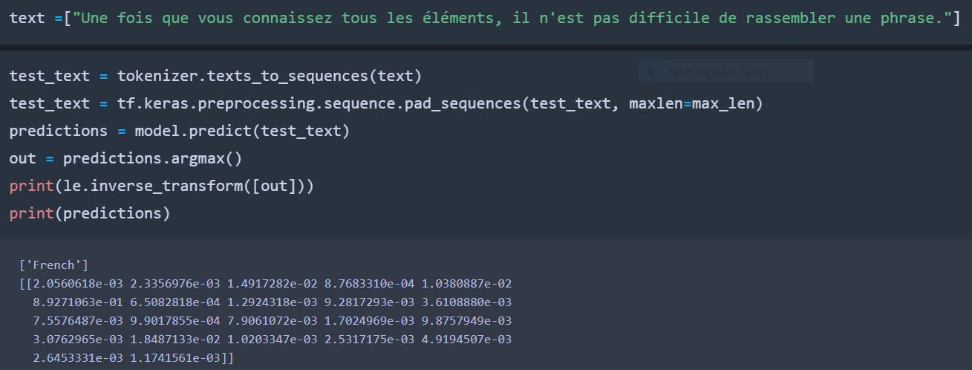

Slide 24
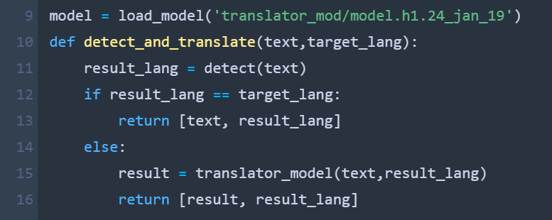
Integration of both:
We integrate both the models by saving them individually and calling them together in a separate code file. Then we use both together where we create a function a that takes the parameters the sentence which we want to identify and translate.
At first the sentence is identified and then translated using both models then the function shall return both the values as a list of strings.
This will be taken by the another function that handles the HTML forms and the results shall be displayed onto the HTML page.

Slide 25
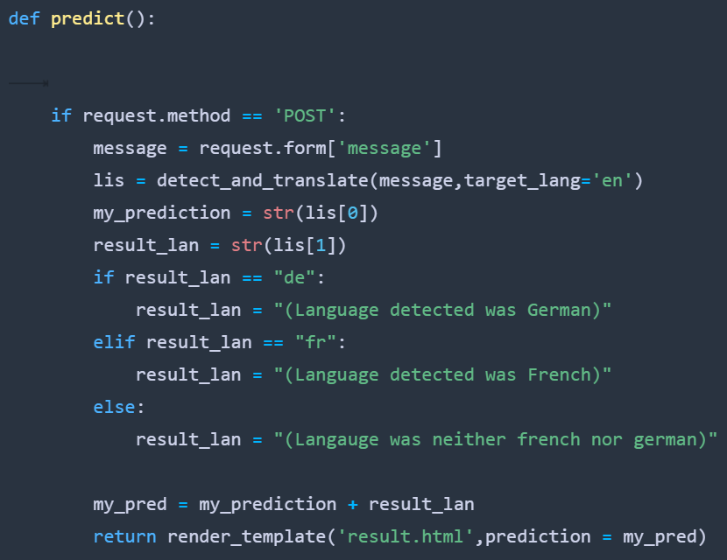

Slide 26
Front end:
The HTML and CSS file written and saved in the templates and static folders respectively. There are two HTML files developed one for the page where we enter a sentence to be translated and the other is for the page where results are displayed.
Thus the Flask API has been used alongside python so as to handle the forms in HTML. Thus we have used .py extension to save the frontendcd file in python flask application.
Then we have also used the Anaconda cmd prompt to launch our flask application on the Chrome web browser.

Slide 27
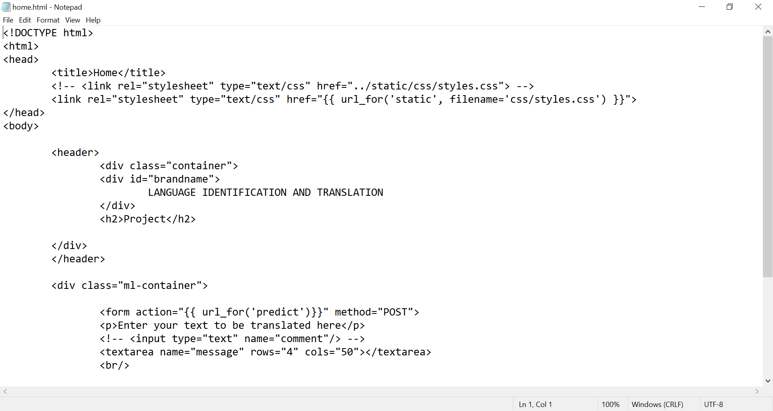

Slide 28
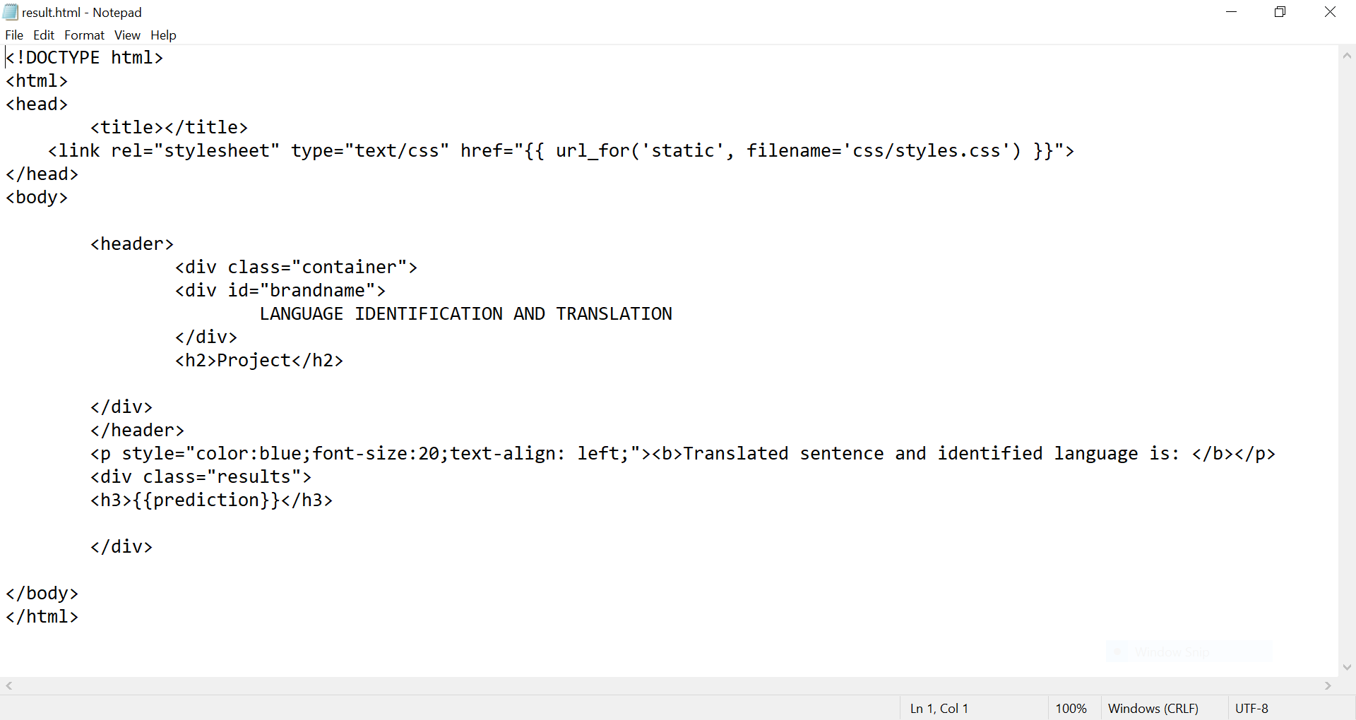

Slide 29
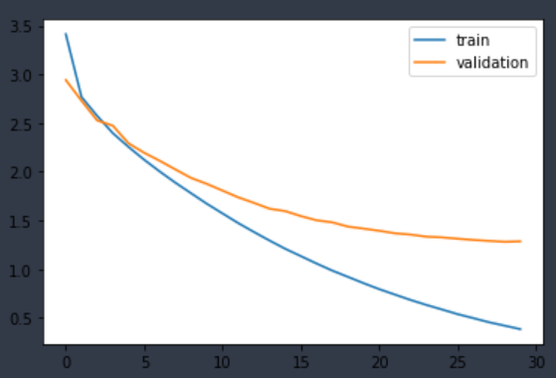
RESULTS
Language Translation:
As one could observe the model has got stabilised after 22 epochs or so. Thus any further training would lead to overfitting.
The results which we got were quite intuitive. The results indicate that the model which we have implemented is able to grasp the context of the sentence and translate the same.
Thus the model we implemented using LSTM with encoder and decoder methodology has worked out and is now ready for the implementation of the language identification systems.

Slide 30
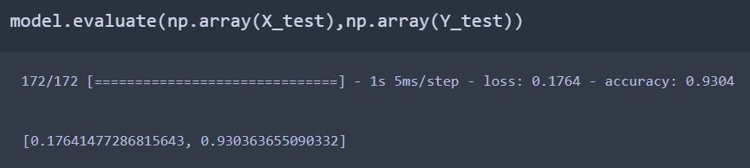
Language Identification:
As one could observe the number of epochs taken is 3. We have evaluated the model on the testing data where we got an accuracy of 93%.
Then we tend to pick up the labels encoded for each language and then we try to give them a trial test over a sentence from a language. At first we gave french and then we gave another french sentence.
Even though the model has been trained on the german and french, the 2nd french sentence was quite misrepresented by the model built.

Slide 31
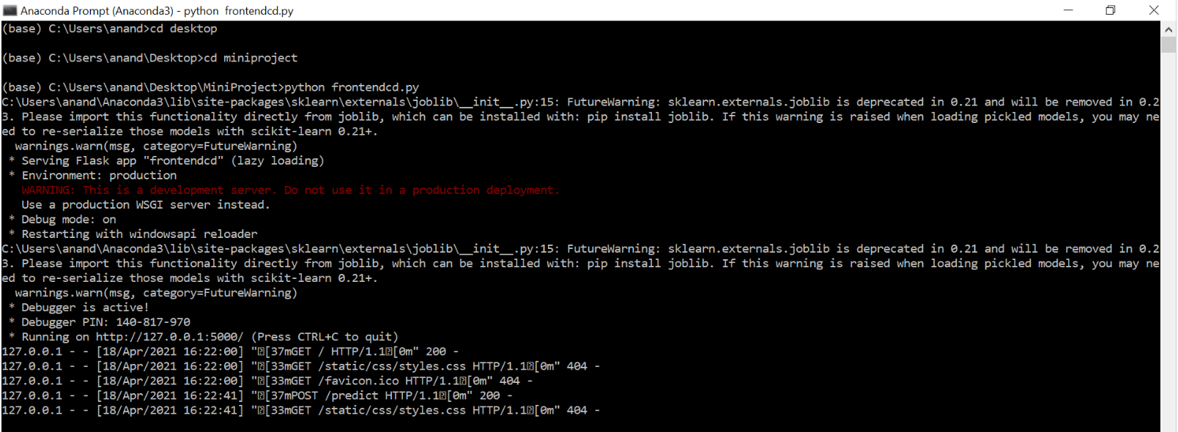
Final Result:
The following are the snapshots from the results that we got by running the flask code. At first we have given the input as ich bin in german and then pressed the button below. On the 2nd page we would get the results as I am ( Language detected was German ) which is the accurate output.

Slide 32
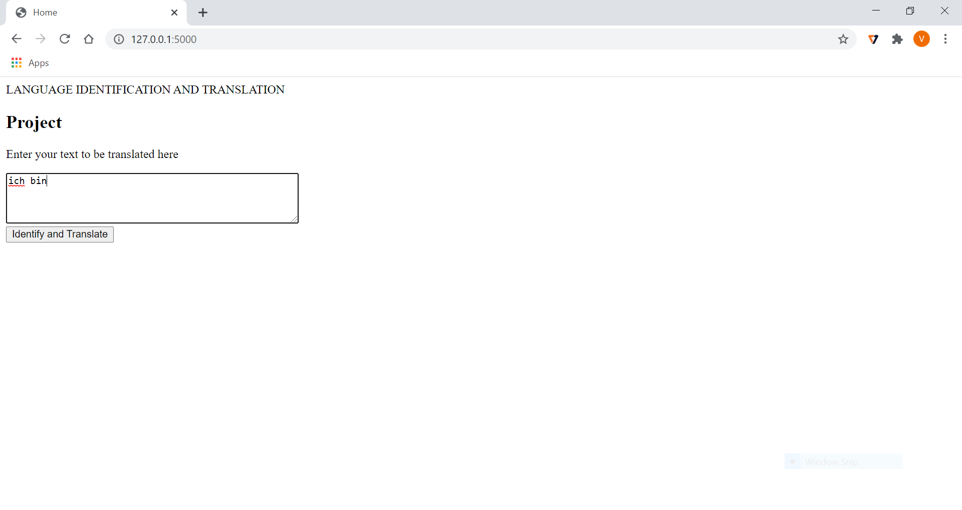

Slide 33
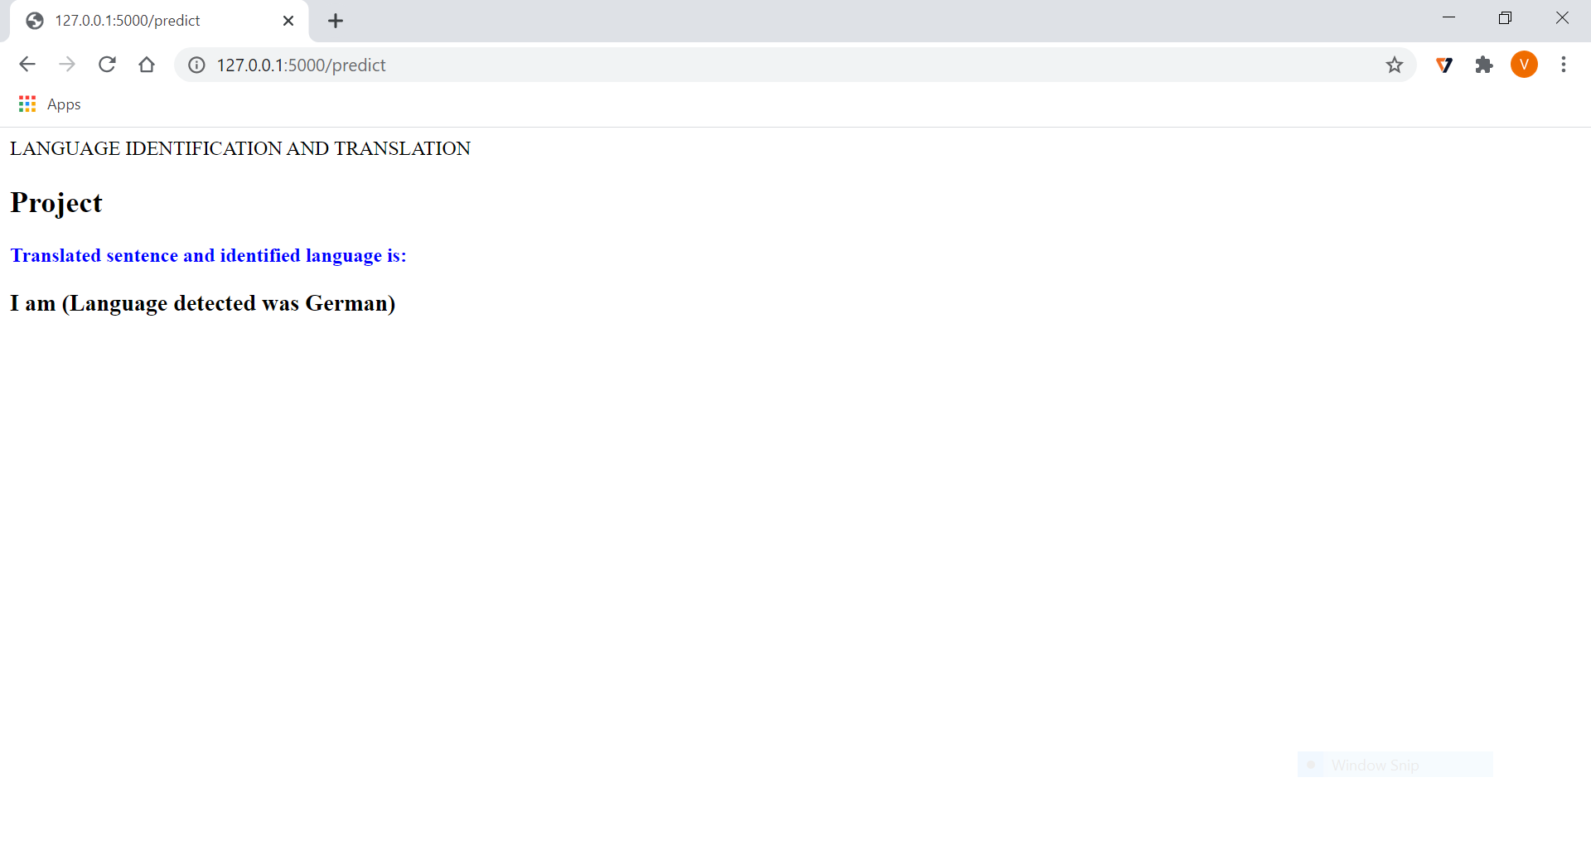

Slide 34
Conclusion
Hence the combination of the Recurrent Neural Networks LSTM’s with encoder and decoder models has resulted in a greater a improvement in terms of accuracy and could be used to build a LID that is a Language IDentification and translation model where the inputs in the format of text. The features extraction capabilities during the preprocessing phase could be utilized to extract the data about the features of the text data and the same could be used in classifying or identifying the language by using the LSTM powerful information extraction that is helpful in classification based on that information. The problem of language identification in the domain of images and the translation of the extracted language input into a text format could be achieved using this the LSTM and encoder and decoder capabilities.

Slide 35
References
Automatic Language Identification Using Deep Neural Networks by Ignacio Lopez-Moreno , Javier Gonzalez-Dominguez,Oldrich Plchot, David Martinez, Joaquin Gonzalez-Rodriguez , Pedro Moreno.
Language Identification from Text Documents by Priyank Mathur, Arkajyoti Misra, Emrah Budur.
Language Identification Using Deep Convolutional Recurrent Neural Networks by Christian Bartz, Tom Herold , Haojin Yang and Christoph Meinel.
Deep Learning A-Z course by Kirill Eremenko and Ponteves from Udemy.
Deep Learning course from Analytics Vidhya.
Machine Learning A-Z course by Kirill Eremenko and Ponteves from Udemy.
Data Science Today website for RNN and CNN.
Y. K. Muthusamy, E. Barnard and R. A. Cole, "Reviewing automatic language identification," in IEEE Signal Processing Magazine, vol. 11, no. 4, pp. 33-41, Oct. 1994, doi: 10.1109/79.317925.

Slide 36
E. Ambikairajah, H. Li, L. Wang, B. Yin and V. Sethu, "Language Identification: A Tutorial," in IEEE Circuits and Systems Magazine, vol. 11, no. 2, pp. 82-108, Second quarter 2011, doi: 10.1109/MCAS.2011.941081.
M. A. Zissman, "Comparison of four approaches to automatic language identification of telephone speech," in IEEE Transactions on Speech and Audio Processing, vol. 4, no. 1, pp. 31-, Jan. 1996, doi: 10.1109/TSA.1996.481450.
L. Ferrer, N. Scheffer and E. Shriberg, "A comparison of approaches for modeling prosodic features in speaker recognition," 2010 IEEE International Conference on Acoustics, Speech and Signal Processing, 2010, pp. 4414-4417, doi: 10.1109/ICASSP.2010.5495632.

Slide 37
THANK YOU!!!

